Slide 1
IHE Webinar: Cross-Enterprise Document Sharing (XDS)
Bill Majurski
NIST
Co-Chair IHE IT Infrastructure Technical Committee

Slide 2
Outline
Hi-level architecture review
Other Relevant Profiles
Metadata design
Supporting Infrastructure
Testing & Resources
Questions/Open Topics

Slide 3
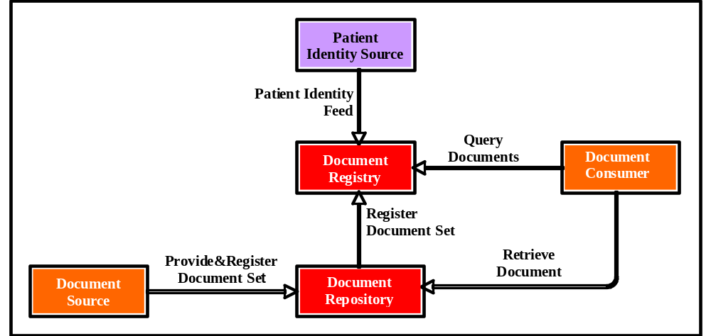
Cross-Enterprise Document Sharing (XDS)
Transaction Diagram

Slide 4
Other Relevant Profiles
CT (Consistent Time) - network time
ATNA
  Node authentication
  Event logging
PIX
  Patient Identity Domains
  Affinity Domain
  Pix XREF Mgr
PDQ (Patient Demographics Query)
  PatientID lookup based on Patient Demographics

Slide 5
ebXML Registry vs XDS
XDS is a Profile of the ebXML Registry standard
ebXML Registry is two standards
  ebRIM (Registry Info Model)
  ebRS (Registry Services - protocols)
XDS uses a SMALL subset of ebRIM and ebRS

Slide 6
ebRIM
ebRIM defines a language for describing documents
This language is constructed as objects and attributes of objects
It is expressed as XML
AKA Metadata

Slide 7
ebRS
Defines the methods/verbs/requests

Slide 8
Submission
From Doc Src to Repository
Contents:
  Metadata
  0 or more Documents
Encoding: SOAP with Attachments

Slide 9
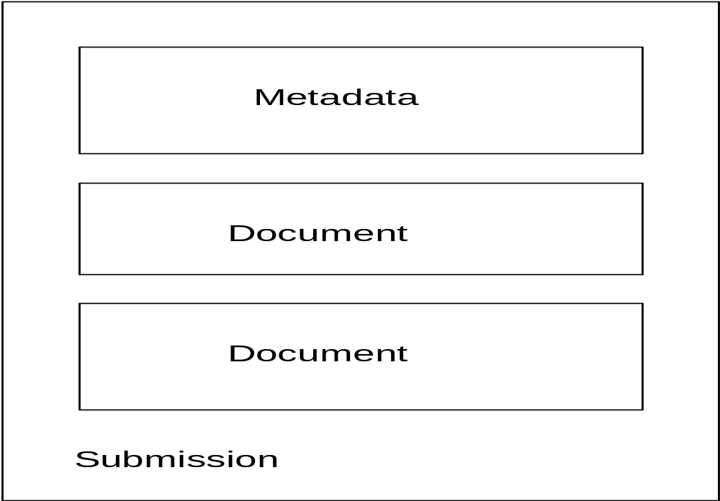
Submission

Slide 10
Protocol Layering
Metadata & Documents
within
SOAP with Attachments
within
HTTP Post
within
…

Slide 11
Query
ebRIM defines relational views into metadata storage
Queries are written in subset of SQL
XDS defines the necessary queries

Slide 12
Key ebRS Methods
Document Source
SubmitObjectsRequest
Document Consumer
AdhocQueryRequst
Registry Adaptor
ApproveObjectsRequest
DeprecateObjectsRequest

Slide 13
Metadata Design
How to speak Registry
(It’s easier than Klingon)

Slide 14
Some important ebRIM objects are…
ebRIM element | Description
ExtrinsicObject | Represents document in Repository
RegistryPackage | ‘folder’ mechanism
Association | Link Bidirectional Typed

Slide 15
Primary XDS Objects
XDSDocumentEntry (ExtrinsicObject)
Represents document in repository
Contains many detailed attributes
XDSSubmissionSet (RegistryPackage)
Records
  Documents submitted together
  Significant clinical events
Contains many detailed attributes

Slide 16
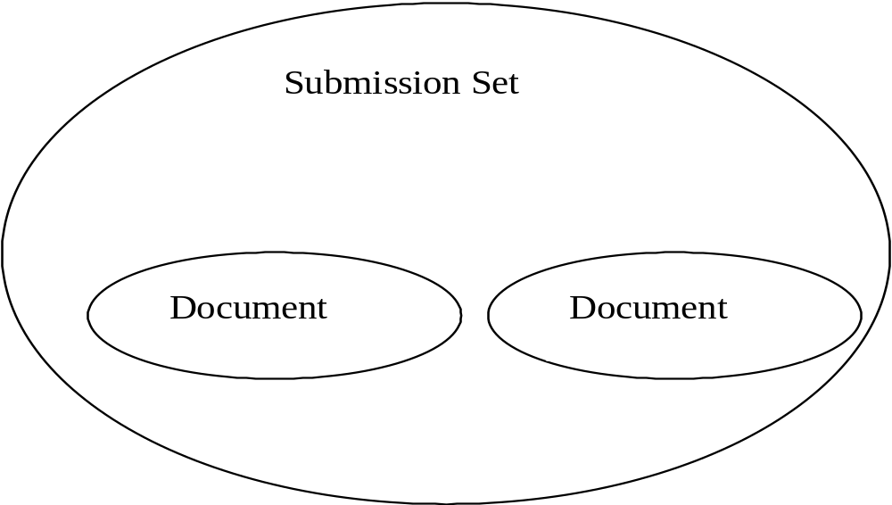
Basic Submission

Slide 17
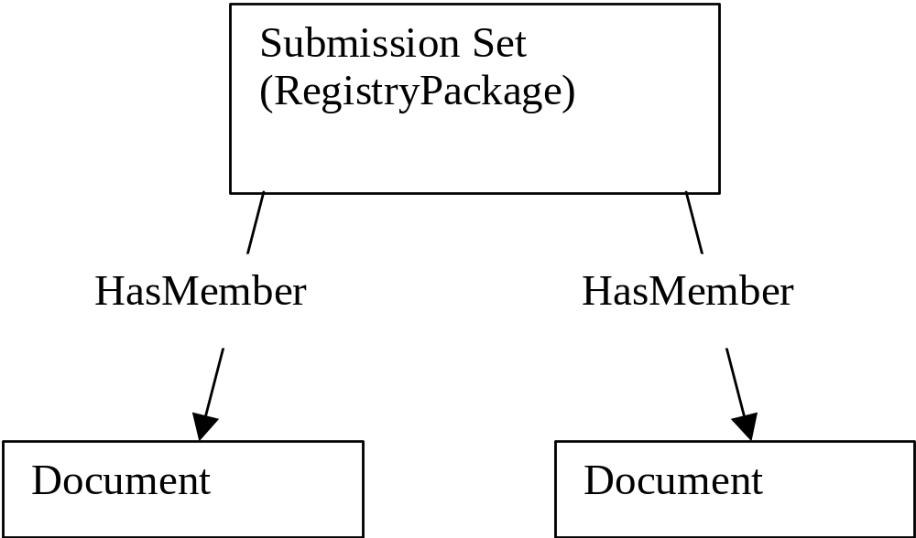
Same Basic Submission

Slide 18
A Document is…
A bit stream stored in a Repository
A metadata element in the Registry representing the content in the Repository
XDSDocumentEntry
ExtrinsicObject

Slide 19
Questions
before we look at XML?

Slide 20
XML - XDSDocumentEntry
<rim:ObjectRef id="urn:uuid:7edca82f-054d-47f2-a032-9b2a5b5186c1" />
<rim:ExtrinsicObject
objectType="urn:uuid:7edca82f-054d-47f2-a032-9b2a5b5186c1" >
…
<rim:/ExtrinsicObject>
Declares object in registry
Notes:
The objectType UUID for XDSDocumentEntry is defined by XDS. ObjectRef declares that a UUID is not defined within the submission. Instead it is expected to be found within the registry. This is very similar to a Pascal ‘extern’ declaration.

Slide 21
XML - XDSSubmissionSet
<rim:RegistryPackage id=“ss”>
…
</rim:RegistryPackage>
<rim:Classification
classifiedObject=“ss”
classificationNode="urn:uuid:a54d6aa5-d40d-43f9-88c5-b4633d873bdd"/>
<rim:ObjectRef id="urn:uuid:a54d6aa5-d40d-43f9-88c5-b4633d873bdd"/>
Defines submission set
Notes:
The classificationNode for XDSSubmissionSet is defined by XDS.

Slide 22
XML - adding Document to Submission Set
<rim:ExtrinsicObject id=“doc”>
…
</rim:ExtrinsicObject>
<rim:RegistryPackage id=“ss”
…
</rim:RegistryPackage>
<rim:Association
associationType="HasMember"
sourceObject=”ss"
targetObject=”doc">

Slide 23
XML - Submission
<rs:SubmitObjectsRequest>
<rs:LeafRegistryObjectList>
<rim:ExtrinsicObject>
…
</rim:ExtrinsicObject>
<rim:RegistryPackage> …
</rim:RegistryPackage>
…
</rs:LeafRegistryObjectList>
</rs:SubmitObjectsRequest>

Slide 24
XML - Attributes
XDSDocumentEntry and XDSSubmissionSet
Large number of attributes defined by XDS
Some Required, some Optional
Tables 3.14.4.1-5 and 3.14.4.1-6 define attributes with examples

Slide 25
XML - Attribute Types
Main
Slot
Classification
External Identifier

Slide 26
XML - Main Attribute Type
Attribute of main element
<rim:ExtrinsicObject
objectType=“”
mimeType=“text/xml”>
Name and Description elements
  <rim:Name>
  <rim:LocalizedString value = "test 11731"/>
  </rim:Name>
Applies to submission set as well

Slide 27
XML - Slot Attribute Type
Name/Value pairing
May have multiple unordered values (controlled by XDS)
<rim:Slot name="authorPerson">
<rim:ValueList> <rim:Value>^Welby^Marcus^^^Dr^MD</rim:Value>
<rim:Value>^Jones^Barnaby^^^Dr^MD</rim:Value>
</rim:ValueList>
</rim:Slot>

Slide 28
XML - Classification
3 part coding (coding scheme, code value, code value display name)
<rim:Classification classificationScheme= "urn:uuid:f4f85eac-e6cb-4883-b524-f2705394840f" classifiedObject="theDocument" nodeRepresentation=”code_value" >
<rim:Name>
<rim:LocalizedString value=”code value display name"/>
</rim:Name>
<rim:Slot name="codingScheme">
<rim:ValueList>
<rim:Value>Coding scheme name</rim:Value>
</rim:ValueList>
</rim:Slot>
</rim:Classification>
Which coded attribute

Slide 29
XML - Classification (2)
classificationScheme - identifies which coded attribute (classCode, eventCode, healthcareFacilityTypeCode, etc.)

Slide 30
XML - External Identifiers
Labeled with type, value,
and name
<rim:ExternalIdentifier
  identificationScheme="urn:uuid:58a6f841-87b3-4a3e-92fd-a8ffeff98427"
  value= “6578946^^^&amp;1.3.6.1.4.1.21367.2005.3.7&amp;ISO">
<rim:Name>
<rim:LocalizedString
    value = "XdsDocumentEntry.patientId"/>
</rim:Name>
</rim:ExternalIdentifier>
type
value
name

Slide 31
Attribute Order
The order in which attributes are coded is important/restricted
Main (element attributes and title/description)
Slots
Classifications
External Identifiers

Slide 32
Submission Response
<RegistryResponse
codeContext="Test 11710" status="Success" >
</RegistryResponse>

Slide 33
SOAP
HTTP Header
---blank line---
HTTP Body - SOAP encoded

Slide 34
HTTP/SOAP Header
POST /ebxmlrr/registry/soap HTTP/1.1
Accept: */*
Accept-Language: en-us
Referer: http://sst138.ncsl.nist.gov/web/soap/soap-diag-client.htm
Content-Type: text/xml; charset=utf-8
SOAPAction: ""
Accept-Encoding: gzip, deflate
User-Agent: Mozilla/4.0 (compatible; MSIE 6.0; Windows NT 5.1)
Host: gunshot.ncsl.nist.gov:8080
Connection: Keep-Alive
Cache-Control: no-cache
Content-Length: 851

Slide 35
HTTP/SOAP Body
<?xml version="1.0" ?>
<SOAP-ENV:Envelope xmlns:SOAP-ENV="http://schemas.xmlsoap.org/soap/envelope/">
<SOAP-ENV:Header/>
<SOAP-ENV:Body>
<rs:SubmitObjectsRequest>
…
</rs:SubmitObjectsRequest>
</SOAP-ENV:Body>
</SOAP-ENV:Envelope>

Slide 36
SOAP with Attachments
Used to transfer metadata and documents from Document Source to Document Repository

Slide 37
POST /ebxmlrr/registry/soap HTTP/1.1
Content-Type: multipart/related; type="text/xml"; boundary=---------------------------7d4285f14803b8
SOAPAction: ""
-----------------------------7d4285f14803b8
Content-Type: text/xml
<?xml version="1.0" ?>
<SOAP-ENV:Envelope xmlns:SOAP-ENV="http://schemas.xmlsoap.org/soap/envelope/">
<SOAP-ENV:Header/>
<SOAP-ENV:Body>
<rs:SubmitObjectsRequest>
<rs:LeafRegistryObjectList>
<rim:ExtrinsicObject id="doc_1"/>
</rs:LeafRegistryObjectList>
</rs:SubmitObjectsRequest>
</SOAP-ENV:Body>
</SOAP-ENV:Envelope>
-----------------------------7d4285f14803b8
Content-Type: text/xml
Content-Id: <doc_1>
<books>
<book isbn="0345374827"><title>The Great Shark Hunt</title>
<author>Hunter S. Thompson</author></book>
<book><title>Life with Father</title><author>Clarence Day</author></book>
</books>
-----------------------------7d4285f14803b8--
hdr
metadata
doc
Note extra dashes

Slide 38
Supporting Infrastructure
NIST Implementation

Slide 39
Basics
Tomcat (assuming Java)
Apache - supports bidirectional authentication (half of ATNA)
Ebxmlrr - Source Forge project
Iheos - Source Forge project

Slide 40
Testing & Resources

Slide 41
Resources on ihe.net
Schema
Examples
Registry initialization metadata

Slide 42
Test Kit
Defines all tests for all XDS transactions including optional ones
Includes example source code and metadata

Slide 43
Metadata Cookbook
Primer on XDS metadata
Will be updated for this season

Slide 44
NIST Public Registry
Implements Registry and Repository actors
Instrumented to capture and log all events
Logs viewable by tester
Web page for tester to register patient IDs for testing
Will be used for pre-Connectathon testing of Doc Src and Doc Con actors
Will be present at Connectathon
Will be present at HIMSS

Slide 45
Test Result Reporting
Will use Web tool
Web tool, XDS test logging, XDS test requirements all linked

Slide 46
Questions?

